Slide 1
REAL NUMBERS
INTEGRATED MATHEMATICS

Slide 2
Objectives
Students will distinguish between rational and irrational numbers.
Students will calculate the decimal expansion of a fraction, the
faction of a terminating decimal expansion, and the fraction of a
repeating decimal expansion.

Slide 3
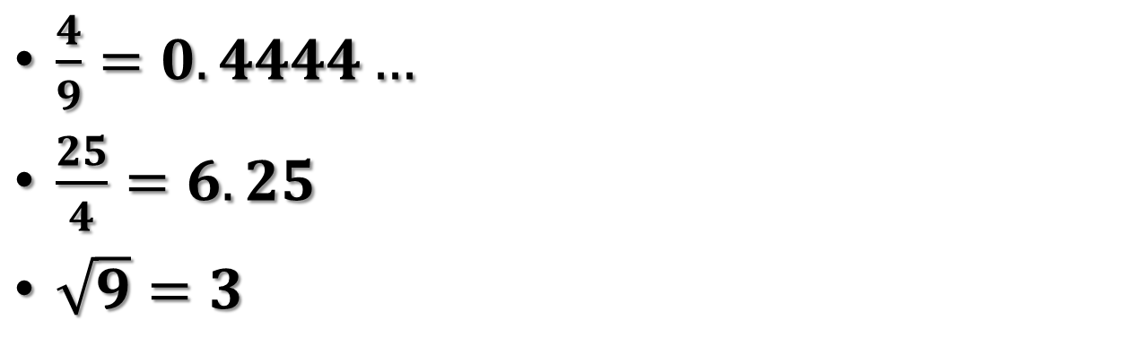
Rational Numbers
Rational Numbers: Numbers that can be written as fractions.
All rational numbers can be written as terminating or repeating decimals.
Examples of Rational Numbers
$\frac{4}{9}=0.4444…$
$\frac{25}{4}=6.25$
$\sqrt{9}=3$

Slide 4

Irrational Numbers
Irrational Numbers: Non-terminating, non-repeating decimals and cannot be written as fractions.
The square roots that are not perfect squares are irrational numbers.
Examples of Irrational Numbers
$π=3.14159…$
$e=2.71828…$
$\sqrt{2}=1.4142…$
$\sqrt{17}=4.1231…$

Slide 5
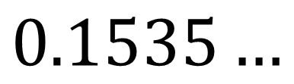
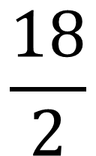

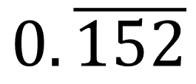
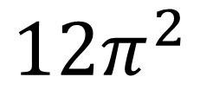
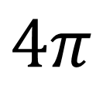
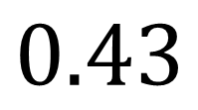
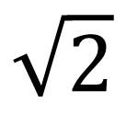
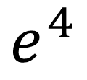
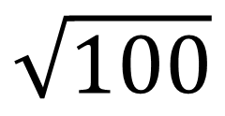


Classify the Numbers
$$4π$$
$$0.43$$
$$\sqrt{100}$$
$$6$$
$$0.\overline{152}$$
$$\sqrt{2}$$
$$\frac{4}{7}$$
$$0.1535…$$
$$12π^{2}$$
$$\frac{e}{4}$$
$$\frac{18}{2}$$
$$e^{4}$$

Slide 6
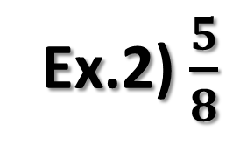
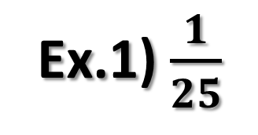
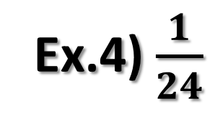
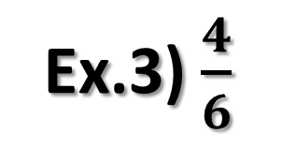
Decimal Expansion
To find the decimal expansion of a fraction, divide the numerator by the denominator.
Ex.1) $\frac{1}{25}$
Ex.3) $\frac{4}{6}$
Ex.2) $\frac{5}{8}$
Ex.4) $\frac{1}{24}$

Slide 7
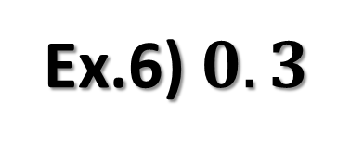
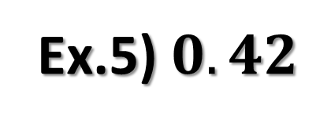
Decimal Expansion
A terminating decimal expansion can be written as a fraction by using the value of its smallest decimal place.
Ex.5) $0.42$
Ex.6) $0.3$

Slide 8
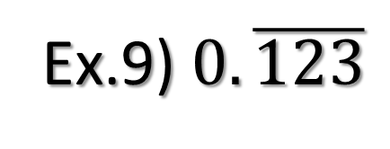
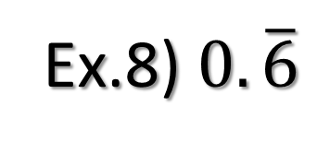
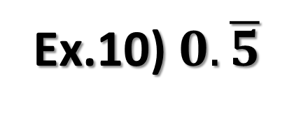
Decimal Expansion
A repeating decimal expansion can be written as a fraction by writing the repeating number in the numerator and digits of the number 9 in the denominator.
Ex.8) $0.\overline{6}$
Ex.10) $0.\overline{5}$
Ex.9) $0.\overline{123}$

